Slide 1
A Brief Introduction to C++11/14/17
Haizhao Dai
Notes:
NVCC only supports C++17.

Slide 2
Overview
C++ is becoming different from C.
C++ is becoming Python …
C++ is moving more computations in compile time.
In this slice, nothing related to multi-threads in C++.

Slide 3
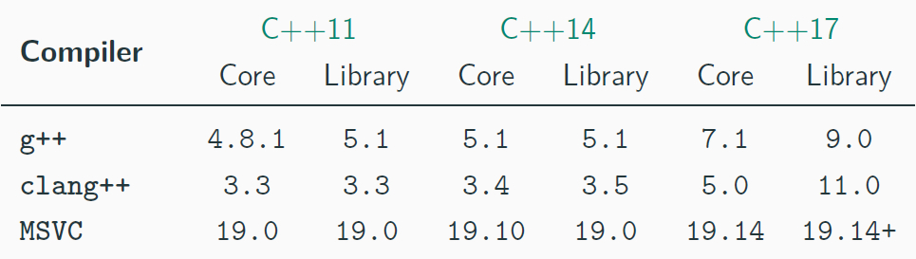
How to Compile?
g++ -std=c++11 <program.cpp> -o program
set(CMAKE_CXX_STANDARD 17)
Notes:
14/1x/1y, 20/2a/2b

Slide 4
How to Compile?
#if defined(__cplusplus)
std::cout << "__cplusplus = " << __cplusplus << "\n";
#if (__cplusplus == 199711L)
std::cout << "ISO C++ 1998/2003\n";
#elif (__cplusplus == 201103L)
std::cout << "ISO C++ 2011\n";
#elif (__cplusplus == 201402L)
std::cout << "ISO C++ 2014\n";
#elif (__cplusplus == 201703L)
std::cout << "ISO C++ 2017\n";
#elif (__cplusplus == 202002L)
std::cout << "ISO C++ 2020\n";
#endif
#endif
Notes:
14/1x/1y, 20/2a/2b

Slide 5
What is new in C++11?

Slide 6
C++11 ( Default and Delete )
The compiler will generate methods that are marked default and prevent you from using deleted methods.
class Noncopyable {
public:
Noncopyable() = default;
Noncopyable(const Noncopyable&) = delete;
Noncopyable& operator=(const Noncopyable&) = delete;
}

Slide 7
C++11 ( Override and Final )
override, let compiler check if a method gets overridden validly.
final, mark a method virtual and underivable.
class Parent {
virtual void f();
virtual void g() final;
};
class Child : public Parent {
virtual void f() override; // valid
virtual void f(int) override; // invalid, no corresponding signature in parent class
virtual void g() override; // invalid, `g` marked `final`
};
class Bachelor final {};
class BachelorChild : public Bachelor {} // invalid, `Bachelor` marked `final`

Slide 8
C++11 ( Delegation and Inherit Constructor )
class Foo {
public:
Foo(char x, int y) {}
Foo(int y) : Foo('a', y) {} // Foo(int) delegates to Foo(char, int)
};
class Bar : public Foo {
public:
using Foo::Foo;
};
// main
Foo(1);
Bar(1);

Slide 9
C++11 ( Rvalue Reference and Move Semantics)
T&& extends the lifetime of rvalue.
Rvalue: Literal, return value, value generated by std::move().
Move semantics: move the value of one variable to the other.
Move constructor and move assignment operator are designed for handling rvalue arguments.

Slide 10
C++11 ( Use of Rvalue )
T&& the universal reference.
Perfect Forwarding using std::forward().
void g(X&) { std::cout << "X&\n"; }
void g(X const&) { std::cout << "X const&\n"; }
void g(X&&) { std::cout << "X&&\n"; }
void f(X& val) { g(val); }
void f(X const& val) { g(val); }
void f(X&& val) { g(val); g(std::move(val)); }
template <typename T>
void h(T&& val) { g(val); g(std::forward<T>(val)); }
// main
X x; X const xc;
f(x); f(xc); f(X{}); f(std::move(c)); // X& | X const& | X&, X&& | X&, X&&
h(x); h(xc); h(X{}); h(std::move(c)); // X&, X& | X const&, X const& | X&, X&& | X&, X&&

Slide 11
C++11 ( Use of Rvalue )
Exchange the value with give rvalue std::exchange() (requires move constructor and move assignment operator). (C++14)
// Fibonacci
for (int a{0}, b{1}; a < 100; a = std::exchange(b, a + b))
std::cout << a << ", ";

Slide 12
C++11 ( Range-based for Loop )
Any object with well-defined begin and end.
for (range_declaration: range_expression)
loop_statement;
// expand to...
auto&& __range = range_expression;
auto __begin = begin_expr;
auto __end = end_expr;
for ( ; __begin != __end; ++__begin) {
range_declaration = *__begin;
loop_statement;
}
// pointer is also a kind of iterator
T const* p === const_iterator<T> p
T* const p === const iterator<T> p
Notes:
- `T const* p` 是一个指向 `T` 型常量的指针，可以修改指针指向，不能修改它所指向的值。
- `T* const p` 是一个指向 `T` 型的常量指针，不能修改指针指向，可以修改它所指向的值。

Slide 13
C++11 ( Range-based for Loop )
for (auto&& i : "abcd")
std::cout << i << " "; // a b c d
std::vector<int> v { 1, 2, 3 };
for (auto&& i : v)
std::cout << i << " "; // 1 2 3
int array[3][2] = { {1, 2}, {3, 4}, {5, 6} };
for (auto&& [x1, y1] : array) // Structure binding
std::cout << x1 << ", " << y1 << " "; // 1, 2 3, 4 5, 6

Slide 14
C++11 ( Type Deduction )
Type deduction for template ( C++98 ).
template <typename T>
void f(ParamType param); // ParamType can be (const) T(*/&/&&)
f(expr);
T is infer from both ParamType and the type of expr.

Slide 15
C++11 ( Type Deduction )
(1) ParamType is pointer or lvalue reference.
If expr is reference, then ignore & or &&.
T = type of expr - decorator of ParamType.
template <typename T>
void f(T& param); // ParamType = T&
int x = 1; // expr = int
const int cx = x; // expr = const int
const int& rx = x; // expr = const int&
f(x); // T = int, ParamType = int&
f(cx); // T = const int, ParamType = const int&
f(rx); // T = const int, ParamType = const int&

Slide 16
C++11 ( Type Deduction )
(1) ParamType is pointer or lvalue reference.
template <typename T>
void f(T* param); // ParamType = T*
int x = 1; // expr = int
int* px = &x; // expr = int*
const int* cpx = &x; // expr = const int*
f(px); // T = int, ParamType = int*
f(cpx); // T = const int, ParamType = const int*

Slide 17
C++11 ( Type Deduction )
(1) ParamType is pointer or lvalue reference.
T = type of expr - decorator of ParamType.
template <typename T>
void f(const T& param); // ParamType = T&
int x = 1; // expr = int
const int cx = x; // expr = const int
const int& rx = x; // expr = const int&
f(x); // T = int, ParamType = const int&
f(cx); // T = int, ParamType = const int&
f(rx); // T = int, ParamType = const int&

Slide 18
C++11 ( Type Deduction )
(2) ParamType is rvalue reference.
If expr is lvalue reference, then T and ParamType are lvalue reference. If expr is rvalue reference, see (1).
template <typename T>
void f(T&& param); // ParamType = T&&
int x = 1; // expr = int
const int cx = x; // expr = const int
const int& rx = x; // expr = const int&
f(x); // T = int&, ParamType = int&
f(cx); // T = const int&, ParamType = const int&
f(rx); // T = const int&, ParamType = const int&
f(10); // T = int, ParamType = int&&

Slide 19
C++11 ( Type Deduction )
(3) ParamType is a raw type, making a copy.
If expr is reference, then ignore & or && and const.
template <typename T>
void f(T param); // ParamType = T
int x = 1; // expr = int
const int cx = x; // expr = const int
const int& rx = x; // expr = const int&
const int* const cxc = &x; // expr = const int* const
f(x); // T = int, ParamType = int
f(cx); // T = int, ParamType = int
f(rx); // T = int, ParamType = int
f(cxc); // T = const int*, ParamType = const int*, special case

Slide 20
C++11 ( Type Deduction )
Placeholder type specifier: auto.
For variables, specifies that the type of the variable that is being declared will be automatically deduced from its initializer.
auto param = expr; // exactly the same as template
auto f = [](int x) -> decltype(x * 2) { return x * 2; }; // C++11
auto g = [](int x) { return x * 2; }; // C++14
auto h = [](auto x) { return typeid(x).name(); }; // C++14

Slide 21
C++11 ( Type Deduction )
Decltype specifier: decltype.
It gets the type of an entity or an expression which use in decl/def.
bool f(int) { return true; }
struct A { int x; };
int x = 3;
const A a;
// (x) == *(&x) making it lvalue
decltype(x); // int
decltype((x)); // int&
decltype(f); // bool
decltype((f)); // bool (*)(int)
decltype(a.x); // int
decltype((a.x)); // const int&

Slide 22
C++11 ( Smart Pointers )
Smart pointers are substitution of raw pointers (no arithmetic).
std::shared_ptr<int> p1(new int{1}); // can be nullptr
std::shared_ptr<int> p2 = p1; // p2(p1)
std::shared_ptr<int> p3 = std::move(p2); // (std::move(p2));
std::shared_ptr<int> p4 = std::make_shared<int>(1);
// never do it
int* a = new int{1};
std::shared_ptr<int> p1(a);
std::shared_ptr<int> p2(a);
std::unique_ptr is not shared, support move only.

Slide 23
C++11 ( List / Uniform Initialization)
It safely converts arithmetic types, preventing implicit narrowing.
float f = 1e40; // ok, f == inf
float f{ 1e40 }; // compile error
Direct initialization.
std::vector<int> vi { 1, 2, 3 }; // 1, 2, 3
int i {}; // 0
int* ai = new int[4] { 4, 5, 6 }; // 4, 5, 6, 0
struct Foo {
std::vector<int> mem1 { 1, 2, 3 }; // 1, 2, 3
std::vector<int> mem2; // -1, -2, -3
Foo() : mem2{ -1, -2, -3 } {}
};

Slide 24
C++11 ( List / Uniform Initialization)
Copy initialization.
struct A { int x; int y; };
auto g = [](const A& a) {};
struct B {
A a = { 1, 2 };
A operator[](const A& a) { return { 2, 3 }; };
};
// Above are outside main(). Below are inside main().
A a = { 3, 4 };
a = { 4, 5 };
g({ 5, 6 });
B b = B({ 6, 7 });
b[{ 7, 8 }];

Slide 25
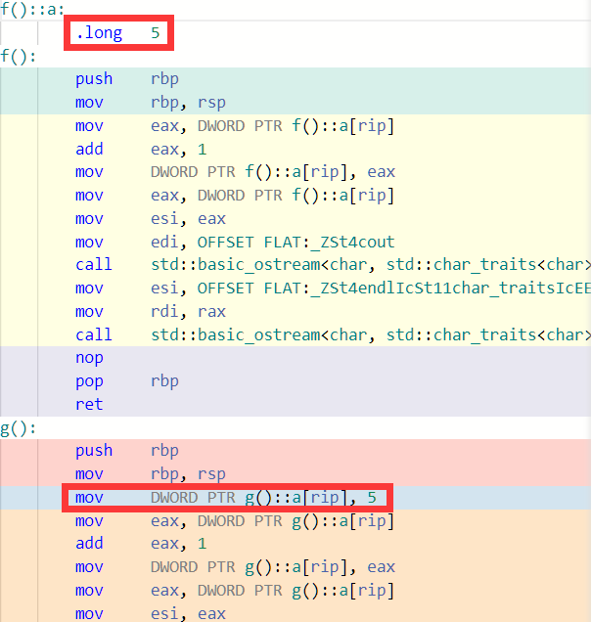
C++11 ( List / Uniform Initialization)
Why uniform initialization?
void f() {
static int a = 5; // init
std::cout << ++a << std::endl;
}
void g() {
static int a; // declaration
a = 5; // assignment
std::cout << ++a << std::endl;
}

Slide 26
C++11 ( Enumerate Type )
enum class or enum struct
A type safe enumerator that is not implicitly convertible to int
enum class RGB : uint8_t { RED, GREEN, BLUE };
enum class HSV : uint8_t { HUE, SATURATION, VALUE };
//! Always initialize `enum class`-typed variables!
//! And never assign an out-of-range value!
RGB rgb = RGB::RED;
HSV hsv = HSV::HUE;
RGB::RED < RGB::GREEN; // OK
rgb == hsv; // CE for different type
int color = (int)rgb; // OK
int color = rgb; // CE for implicit conversion
Prefer enumerator than bool on function parameter.

Slide 27
C++11 ( Constexpr )
constexpr
For variables that are evaluated at compile-time.
Also, it guarantees compile-time evaluation of a function as long as all its arguments are constant.

Slide 28
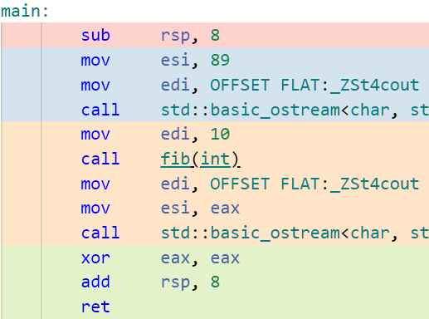
C++11 ( Constexpr )
constexpr
constexpr int fib(int n) {
return (n == 0 || n == 1) ? 1 : fib(n - 1) + fib(n - 2);
}
int main() {
constexpr int ci = 10;
std::cout << fib(ci); // compile-time evaluation
int a = 10; // `a` is determined in run-time.
std::cout << fib(a); // run-time evaluation
return 0;
}

Slide 29
C++11 ( Additional Library )
<array>: wrapped C array.
<valarray>: numpy in C++.
<chrono>: time library.
<random>: random library.
<ratio>: ratio number.
<regex>: regular expression.
<unordered_map>, <unordered_set>: hash table-based dictionary and set.

Slide 30
C++11 ( Additional Library )
std::random_device rd{};
std::mt19937_64 rng(rd());
std::uniform_real_distribution<double> uniform(0.0, 1.0);
auto number = uniform(rng);
auto start = std::chrono::system_clock::now();
// some codes here...
auto end = std::chrono::system_clock::now();
auto durations = std::chrono::system_clock::duration_cast<std::chrono::milliseconds>(end - start).count();

Slide 31
C++11 ( Other Details )
nullptr
In C++, #define NULL 0, so nullptr is needed for overloading.
Fixed width integer types
long long will have width as least 64 bits. But fixed width integer types is recommended: (u)intN_t where N = { 8, 16, 32, 64 }.
Logical operator and or not
They are keywords in C++ now.

Slide 32
C++11 ( Other Details )
Type Aliasing: using.
typedef void (*func)(int, int); // C style
using func = void (*) (int, int); // Equivalent
template <class T>
using Vec = vector<T, Alloc<T>>;
Vec<int> v; // vector<int, Alloc<int>>
Dynamic memory 2D allocation/deallocation ( less efficient )
int n = 3;
int (*A)[4] = new int[n][4];
delete [] A;
auto B = new int[n][n]; // compile error

Slide 33
What is new in C++14?

Slide 34
C++14 ( Other Details )
Binary Literals & Digit Separators
int binary_literal{0b100010};
int digit_separator{1'000'000};
Variable Templates
template <typename T>
constexpr T pi = T(3.1415926535897932385L);
template <typename T>
auto f = []() { std::cout << std::setprecision(20) << pi<T> << '\n'; };
// main().
f<float>(); // 3.1415927410125732422
f<double>(); // 3.1415926535897931160
f<long double>(); // 3.1415926535897932385

Slide 35
C++14 ( Other Details )
std::quoted
string a = "unquoted, \"quoted\"";
std::cout << a << " | " << std::quoted(a) << '\n’;
// unquoted, "quoted" | "unquoted, \"quoted\""
string b = "unquoted, ?quoted?";
std::cout << b << " | " << std::quoted(b, '?', '!') << '\n';
// unquoted, "quoted" | ?unquoted, !?quoted!??

Slide 36
What is new in C++17?

Slide 37
C++17 ( Structure Binding )
Structure binding can be apply to array, tuple-like type and structure.
int arr[2] = { 1, 2 };
auto [x, y] = arr; // copy
auto& [xr, yr] = arr; // reference
float x1{}; char y1{}; int z1{};
std::tuple<float&, char&&, int> tpl(x1, std::move(y1), z1);
const auto& [a, b, c] = tpl;
struct S { mutable int x1; volatile double y1;};
S f() { return S{1, 2.3}; }
const auto [x, y] = f();

Slide 38
C++17 ( Class Template Argument Deduction )
One need not specify the type of class template.
void f(const std::vector<int>& v) {};
int main() {
std::pair<int, double> a { 1, 1.0 };
std::pair b { 1, 1.0 };
f(std::vector<int> { 1, 2, 3 }); // cumbersome
f({ 1, 2, 3 }); // limited
f(std::vector { 1, 2, 3 }); // best!
}

Slide 39
C++17 ( Type Deduction )
Default value of template ( Any type except for floating point and class ( until C++20 ) ).
template<typename T, int S = sizeof(T) + 1>
void f(T) { std::cout << S; }
f(3) // 5
Non-type template parameters declared with auto.
template <auto n> struct A {};
A<1> a;
int b = 1; A<b> c;
A<int> d;// error

Slide 40
C++17 ( Inline )
Until C++17, it is a optimization marker.
Since C++17, it is a decorator of static variable. Eliminating the main obstacle to packaging C++ code as header-only libraries.
// a.hpp
inline int foo(int x) {
inline static int factor = 1;
return x * (factor++);
}
// b1.cpp
int bar1() { return foo(1); }
// b2.cpp
int bar2() { return foo(2); }
// main
bar1() + bar2(); // 5

Slide 41
C++17 ( Attributes )
Attribute | Description
[[noreturn]](C++11) | indicates that the function does not return
[[carries_dependency]](C++11) | indicates that dependency chain in release-consume std::memory_order propagates in and out of the function
[[deprecated]](C++14) [[deprecated("reason")]](C++14) | indicates that the use of the name or entity declared with this attribute is allowed, but discouraged for some reason
[[fallthrough]](C++17) | indicates that the fall through from the previous case label is intentional and should not be diagnosed by a compiler that warns on fall-through
[[nodiscard]](C++17) [[nodiscard("reason")]](C++20) | encourages the compiler to issue a warning if the return value is discarded
[[maybe_unused]](C++17) | suppresses compiler warnings on unused entities, if any

Slide 42
C++17 ( Attributes )
[[noreturn, maybe_unused]]
void f [[noreturn, maybe_unused]] () { while(1); }
[[nodiscard]] int g() { return 1; }
// __attribute__((nodiscard)) is old style
switch (n) {
case 1:
g();
[[fallthrough]];
case 2: // no warning on fallthrough
case 3:
h();
break;
}

Slide 43
C++17 ( Control Flow with Initialization )
For maintaining the scope of local temporary variable.
if (
char buf[10];
std::fgets(buf, 10, stdin)
) { m[0] += buf; }
switch (auto i = f(); x) {
case 1: return i + x;
}

Slide 44
C++17 ( Other Details )
std::byte b { 0b1010'1010 };
It supports bit operation only, list initialization only.
std::clamp
std::inclusive_scan
std::exclusive_scan
std::hypot
std::lcm
std::gcd

Slide 45
TODO List
Lambda expression
Variadic template and fold-expressions
File system
Tuple
Variant
Order of evaluation

Slide 46
Reference
https://en.cppreference.com/w/ ( C++ Official Document )
https://gcc.godbolt.org/ ( Online Compiler )
https://wandbox.org/ ( Online Code Runner )
“C++ Template: The Complete Guide”

